Slide 1
The Discreet Charm of Multi-pattern Codes
Igor Zavadskyi
Taras Shevchenko National University of Kyiv, Ukraine Computer science department

Slide 2
Statistical loseless compression
$$S=s_{i_{1}}s_{i_{2}}…s_{i_{n}}, { s}_{i}∈Σ; p_{i}=\frac{freq(s_{i})}{n}$$
Decoding speed
$$H0=\sum_{i=1}^{n}{p_{i}∙\log{p_{i}}}$$
Asymmetric
Numeration
Systems
(2013)
Arithmetic (1970s)
Huffman (1952)
???
Compressed size

Slide 3
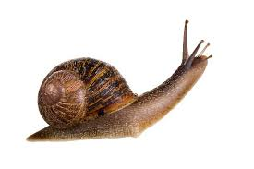
Key features: decoding speed
1
Codes with delimiters
BCT
2
BCMix
3
RPBC, SCDC
4
Multi-delimiter codes, byte-aligned algorithms
5
Fibonacci codes, byte-aligned algorithms
6
Huffman codes, ANS
7
Arithmetic encoding

Slide 4
Key features: search in compressed file
We have developed a new class of variable length prefix codes, so called (; k)-codes, which can be used for efficient data compression.
efficient
Huffman, arithmetic, ANS
–
Codes with delimiters
+

Slide 5
Compressed search: example
Fibonacci code Fib2: delimiter 11. Pattern P=compression.
Search window
100110……………………0110010110…….
codeword
symbol x
х$∈P \underset{⇒}{}$ we can jump over the whole search window

Slide 6
Key features: synchronization
Arithmetic code, ANS and Huffman codes are not synchronizable
error
Codes with delimiters are synchronizable
error

Slide 7
Key features: universality
Task: represent 10³ integers in the range [0;10⁹] with higher probabilities of smaller numbers.
Elias, Golomb, codes with delimiters
+
Huffman, ANS, Arithmetic
–
Application examples
representation of offsets and lengths in LZ77-type compression
differential encoding of colors in image compression

Slide 8
Encoding and decoding
Objects to be encoded are considered as dictionary elements.
Encoding
Decoding
Dict[i] → i → codeword
codeword → i → Dict[i]
There → 15 → 00 00 10 11
00 00 10 11 → 15 → There
is → 12 → 10 10 11
i | Dict[i]
… | …
12 | is
… | …
15 | There
10 10 11 → 12 → is
Bit-by-bit decoding is too slow

Slide 9
Variable-length codes fast decoding: naive approach
codeword
1 | 1 | 1 | 0 | 1 | 0 | 1 | 0 | 1 | 0 | 1 | 0 | 0 | 1 | 0 | 0 | 1 | 0 | 0 | 1 | 0 | 1 | 1 | 0 | 0 | 0 | 1 | 0 | 1 | 0 | 1 | 1
32 bits
Read 32-bit (or 64-bit) value x from the encoded bitstream.
Output the decoded value D(x).
Shift the bitstream by S(x) bits to the left.
F. Giesen. Entropy decoding in oodle data: Huffman decoding on the jaguar. https://fgiesen. wordpress.com/2022/04/04/entropy-decoding-in-oodledata-huffman-decoding-on-the-jaguar/.
Problem: size of the lookup tables D and S (5x2³² or 5x2⁶⁴ bytes).

Slide 10
Naive approach applicability in data compression
Character-based ASCII text
+
Word-based text
–
Asian languages
–
Image and video
–
Lengths and offsets in LZ-77
–
Unbounded integer sequences
–

Slide 11
‘Decoding in parts’ principle
1 | 1 | 1 | 0 | 1 | 0 | 1 | 0 | 1 | 0 | 1 | 0 | 0 | 1 | 0 | 0 | 1 | 0 | 0 | 1 | 1 | 0 | 0 | 0
$$P_{1}$$
$${D(P}_{1})$$
$$P_{2}$$
$${D(P}_{2})$$
$$P_{3}$$
$${D(P}_{3})$$
f result
1) Split a codeword into parts $P_{1},…,P_{m}$.
2) Decode/transform all parts (almost) independently: $D(P_{1}),…,D(P_{m})$.
3) Combine the results of parts decoding using an easily computed function: $f(D\left(P_{1}\right),…,D\left(P_{m}\right))$.
I.O. Zavadskyi. Binary-Coded Ternary Number Representation in Natural Language Text Compression, in Proc. 2022 Data Compression Conference (DCC), pp. 419–428, 2022.

Slide 12
Huffman codes: not applicable for decoding in parts
0 | 0 | 0 | 0 | 0 | 0 | 0 | 0
0
0 | 0 | 0 | 0 | 0 | 0 | 0 | 0
0 | 0 | 0 | 0 | 0 | 0 | 0 | 1
1
0 | 0 | 0 | 0 | 0 | 0 | 1 | 0
2
0 | 0 | 0 | 0 | 0 | 0 | 0 | 0
3
0 | 0 | 0 | 0 | 0 | 0 | 0 | 1
0 | 0 | 0 | 0 | 0 | 0 | 0 | 1
5
0 | 0 | 0 | 0 | 0 | 0 | 1 | 0
8
N. Brisaboa, A. Farina, G. Navarro, and M. Esteller. (s,c)-dense coding: an optimized compression code for natural language text databases. In Proc. SPIRE’03, number 2857, pages 122–136, Manaus, Brazil, 2003.

Slide 13
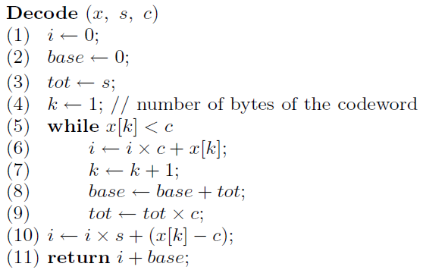
(s,c)-dense codes
Excess over the entropy about 14–17%
1 | 0 | 0 | 0 | 1 | 1 | 1 | 0 | 1 | 0 | 1 | 0 | 0 | 1 | 0 | 0 | 1 | 1 | 0 | 1 | 1 | 0 | 0 | 0
x[1]
x[2]
x[3]
c=
1 | 1 | 0 | 0 | 0 | 0 | 0 | 0
s=256–c
If x[k]≥c
stop
Else
continue
J.S. Culpepper and A. Moffat. Enhanced byte codes with restricted prefix properties.
In String Processing and Information Retrieval: Proc. 12th International Conference, volume 3772, pages 1–12, 2005. (RPBC)
N. Brisaboa, A. Farina, G. Navarro, and M. Esteller. (s,c)-dense coding: an optimized compression code for natural language text databases. In Proc. SPIRE’03, number 2857, pages 122–136, Manaus, Brazil, 2003.

Slide 14
Pattern codes
The code C is a pattern code, if c ∈ C ⇔
c ends with some bit pattern p and does not contain p anywhere else.
All pattern codes are prefix free, thus uniquely decodable, and complete.
Delimiter 11:
11
011
0011
1011
Delimiter 10:
10
010
110
0010
1110
0110
Universal code
Not universal code
K.B. Lakshmanan, ”On universal codeword sets,” IEEE Trans. Inform. Theory, vol. 27, no. 5, pp. 659–662, 1981.
R. Capocelli and A. De Santis, ”Regular universal codeword sets,” IEEE Trans. Inform. Theory, vol. 32, no. 1, pp. 129–133, 1986.

Slide 15
Fibonacci codes
Fibm is the pattern code with delimiter 1…1.
m
There are $F_{i}^{(m)}$ codewords of the code Fibm of length $m+i$.
$${F_{1−m}^{(m)}=…F_{−1}^{(m)}=0; F}_{0}^{(m)}=1;{ F}_{i}^{(m)}=F_{i−m}^{(m)}+…F_{i−1}^{(m)}$$
i | 0 | 1 | 2 | 3 | 4
$${ F}_{i}^{(2)}$$ | 1 | 1 | 2 | 3 | 5
Codewords | 11 | 011 | 0011 1011 | 00011 01011 10011 | 000011, 001011, 010011, 100011, 101011

Slide 16
Fibonacci codes
Apostolico, A. and Fraenkel, A.S. (1987) Robust transmission of unbounded strings using Fibonacci
representations, IEEE Trans. Inform. Theory, 33, pp. 238-245, 1987.
S.T. Klein and M.K. Ben-Nissan, ”On the usefulness of Fibonacci compression codes,” Computer Journal, vol. 53, no. 6, pp. 701–716, Jul. 2010.

Slide 17
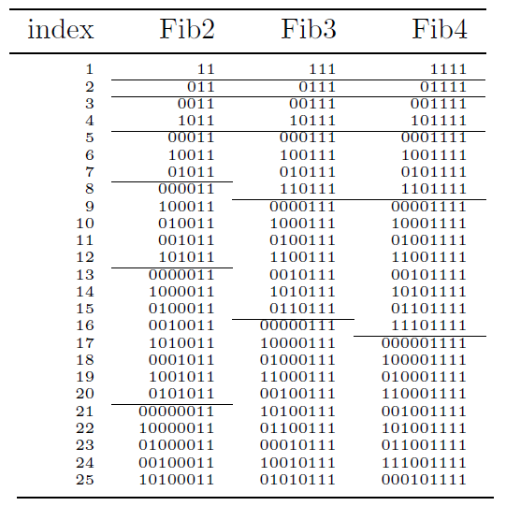
Fibonacci codes encoding and decoding
S.T. Klein and M.K. Ben-Nissan, ”On the usefulness of Fibonacci compression codes,” Computer Journal, vol. 53, no. 6, pp. 701–716, Jul. 2010.
$$X=10110…0(111)=x_{1}…x_{l}(111)$$
$$val\left(X\right)=\sum_{j=1}^{l}{x_{j}F_{j}^{(3)}}+base[l+3] .$$

Slide 18
Fibonacci codes fast decoding
$F_{n}^{(m)}$ can be represented as a linear combination of the n^{th} powers of the roots of the polynomial $x^{m}−x^{m−1}−…−1$. It has only one real root $φ_{(m)}>1$.
Thus, $F_{n}^{(m)} a_{(m)}φ_{(m)}^{n} { F}_{t+j}^{(m)} F_{t}^{(m)}φ_{(m)}^{j}$. For example, $F_{t+j}^{(3)}  {F_{t}^{(3)}⋅(1.8393)}^{j}$.
L
R
0 | 1 | 1 | 1 | 1 | 0 | 1 | 0 | 1 | 1 | 0 | 1 | 1 | 1 | 1 | 0 | 1 | 0 | 0 | 1 | 1 | 0 | 0 | 0
X
$$val\left(L\right)=\sum_{j=1}^{4}{x_{j}F_{j}^{(3)}};val\left(R\right)=\sum_{j=5}^{7}{x_{j}F_{j−4}^{(3)}} .$$
$val\left(X\right)=val\left(L\right)+val\left(R\right)⋅φ_{\left(m\right)}^{4}+base\left[10\right]+\text{Δ}$ .

Slide 19
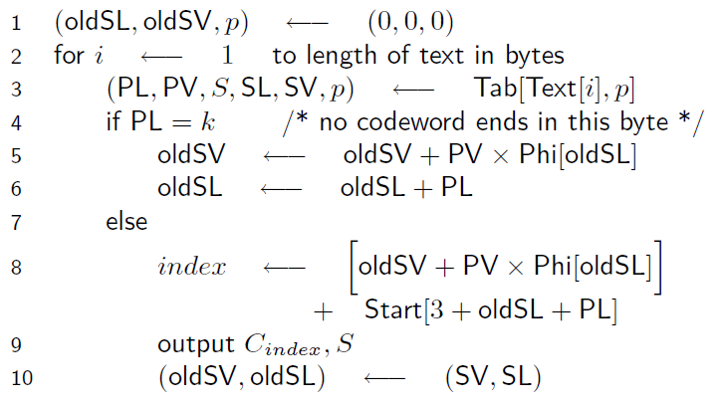
Fibonacci fast decoding
1 | 0 | 0 | 1 | 1 | 0 | 1 | 1 | 1 | 0

Slide 20
Fibonacci fast decoding

Slide 21
Natural language text compression: Fibonacci codes
Fib3
?
Fib3
Fib2
Fib4
Fib4
Fib2

Slide 22
Delimiters
Fibonacci codes
Delimiter Strings
–
–
–
111
1111 11111 11111
Multi-delimiter codes
Delimiter Strings
s
+
+
+
0110
01110
011110
0111110
,
D_{2,3}

Slide 23
Multi-delimiter code: definition
Let m₁ ,… , m_{t} be a sequence of integers, 0 < m₁ <…< m_{t}
The code contains:
- codewords of a form 1…10, … , 1…10
- codewords of a form α01…10, … , α01…10
(type 1)
m₁
m_{t}
(type 2)
m₁
m_{t}
A type 2 codeword contains the delimiter only as a suffix and does not contain any codeword of type 1 as a prefix.

Slide 24
Multi-delimiter codes properties
Completeness
Universality
Synchronizability with the delay 1
Direct search in compressed file
A.V. Anisimov, I.O. Zavadskyi, “Variable-Length Prefix Codes With Multiple Delimiters,”
IEEE Transactions on Information Theory, vol. 63, no. 5, pp. 2885–2895, 2017.

Slide 25
Code D_{2,3} (delimiters 0110, 01110) – example
codewords
1101110010110110
delimiters

Slide 26
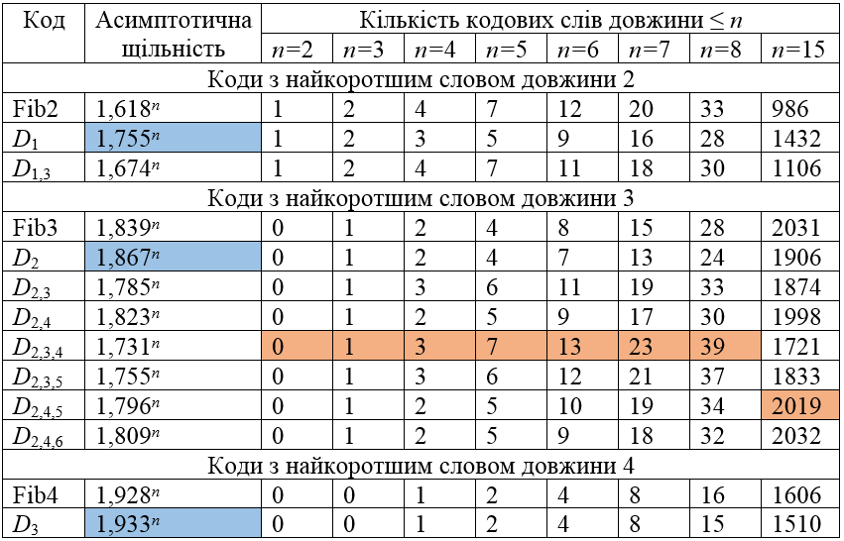
Multi-delimiter codes vs Fibonacci codes
Asymptotic density
Number of codewords of length ≤ n
Code
The codes with the shortest codeword of length 2
The codes with the shortest codeword of length 3
The codes with the shortest codeword of length 4

Slide 27
The flexible family of codes
 | Number of short codewords | Asymptotic density
Longer delimiters
More delimiters

Slide 28
Word based compression – excess over entropy

Slide 29
Main problem: non-monotonousness
110
0110
00110
10110
000110
010110
1
2
4
3
8
5
Dict[1] = the
Dict[2] = and
Dict[4] = of
Dict[3] = to
Dict[8] = that
Dict[5] = in
…
NULL
00001110110
92784
Dict[92784] = Abhor
NULL
…

Slide 30
The reverse codes – key idea
Write all codewords from right to left.
Direct code:
011
0101110
0100101110
0111010010
011
0101110
0100101110
Reverse code:
110
0111010
This way we obtain a non-prefix but uniquely decodable code
with a simple principle of monotonous codeword set construction.

Slide 31
Codeword set construction — R_{2,4–∞} , K={0, 1, 3}
L=3
L=4
L=5
L=6
L=7
1. Replicate the sets of codewords of lengths L−k−1 and append the sequences of the form 01^{k}, k ∈ K.
2. If L = m + 1, m ∈ {m₁,...,m_{t},m_{t+1},…}, append the word 01^{m} to the codeword set.
011
0110
011
0
011
011
0110
0
011000
011010
011110
011001
011111
01100
01101
01111
0
0
0
0
0
0
0
0
01100
01101
01111
01
01111
01
011111
01
01
01
$R_{m_{1},…,m_{t}−∞}$ - a code with infinite number of delimiters.
0111
$$K=\left\{k \right| 0 ≤k<m_{t}, k∉\{m_{1},…,m_{t−1}\}\}$$
0111111

Slide 32
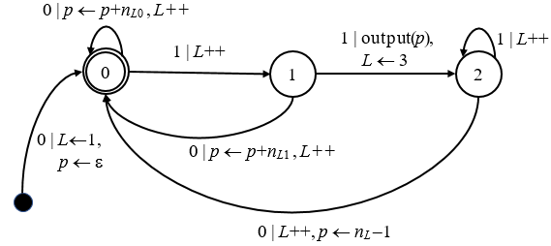
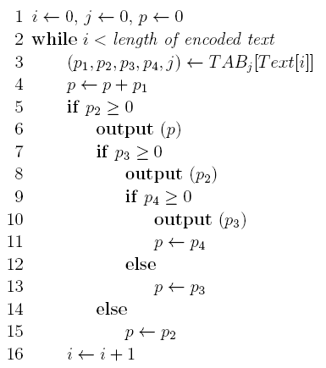
R_{2–∞} decoding
Automaton
Algorithm
input: encoded Text
output: dictionary indices
$$j=3L+state$$

Slide 33
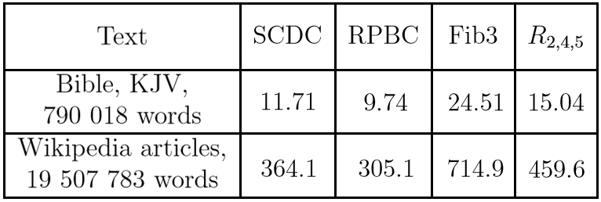
Word based compression
Decoding
time
Compression
ratio

Slide 34
Designed for ultra-fast decoding – BCT-code
Compression ratio | Decoding speed | Synchronization / Compressed search
Arithmetic ANS Huffman Reverse multi-delimiter Fibonacci BCT RPBC SCDC | BCT RPBC SCDC Reverse multi-delimiter Fibonacci Huffman ANS Arithmetic | SCDC Multi-delimiter Fibonacci BCT

Slide 35
Binary-coded ternary number representation
$x=x_{n−1}…x_{0}=3^{n−1}x_{n−1}$+ $…$+ $3x_{1}+x_{0}$
$$x_{i}∈\left\{00;01;10\right\}$$
$$11$$
is not used
G. Frieder and C. Luk, “Algorithms for binary coded balanced and ordinary ternary operations,” IEEE Trans. on Computers, vol. 23, no. 2, pp. 212–215, 1975.

Slide 36
BCT-code
A codeword is composed of trits (pairs of bits):
$$\left\{00;01;10\right\}$$
$$11$$
is the delimiter
Codeword set structure
1-trit | 2-trit | 3-trit
11 | 00 11 01 11 10 11 | 00 00 11 01 00 11 10 00 11 00 01 11 01 01 11 10 01 11 00 10 11 01 10 11 10 10 11
I.O. Zavadskyi. Binary-Coded Ternary Number Representation in Natural Language Text Compression, in Proc. 2022 Data Compression Conference (DCC), pp. 419–428, 2022.

Slide 37
Decoding principle
Position of a codeword inside the group
Position of n-trit codewords group
1-trit codeword | 1-trit | 2-trit codewords | 2-trit codewords | 3-trit codewords |  |  | 3-trit
x | BCT(x) | x | BCT(x) | x | BCT(x) | x | BCT(x) | x | BCT(x)
0 | 11 | 1 2 3 | 00 11 01 11 10 11 | 4 5 6 | 00 00 11 00 01 11 00 10 11 | 7 8 9 | 01 00 11 01 01 11 01 10 11 | 10 11 12 | 10 00 11 10 01 11 10 10 11

Slide 38
Decoding algorithm
input: BCT-codeword, i.e. the sequence of trits $x_{n−1}…x_{0}(11)$.
output: Nonnegative integer x.
$$1. x←0$$
$$2. for i←n−1 downto 0 do$$
$$3. x←3x+x_{i}+1$$

Slide 39
Encoding
input: Nonnegative integer x representing the rank of a word in the dictionary.
output: BCT-codeword $w_{x}$.
$$1. { w}_{x}←"11"$$
$$2. while x>0 do$$
$$3. x←x−1$$
$4.{ w}_{x}←{(x mod 3)}_{2}+w_{x}$ // ‘+’ means concatenation
$$5. x←x div 3$$

Slide 40
BCT – decoding in parts
$$x_{n−1},…,x_{v},{ x}_{v−1},…,x_{0}$$
$$U$$
$$L$$
$$x=x_{0}+1+3\left(x_{1}+1+3\left(x_{2}+1+…3\left(x_{n−1}+1\right)…\right)\right)=$$
$$=x_{0}+1+3\left(x_{1}+…+3\left(x_{v−1}+1\right)\right)+$$
${+ 3}^{v}\left(x_{v}+1+3\left(x_{v+1}+…+3\left(x_{n−1}+1\right)\right)\right)=$
$$L$$
$${L+3}^{v}∙U$$
$$U$$
can be taken from the lookup table

Slide 41
BCT decoding in parts – example
$$v_{1}=2$$
$$v_{2}=3$$
$$v_{3}=1$$
$$x_{5}$$
$$x_{4}$$
$$x_{3}$$
$$x_{2}$$
$$x_{1}$$
$$x_{0}$$
$$c=10 10 01 10 10 00 (11)$$
$$V_{1}$$
$$V_{2}$$
$$V_{3}$$
$$x=x_{0}+1+3^{v_{3}}\left(x_{1}+1+3\left(x_{2}+1+3\left(x_{3}+1\right)\right)+3^{v_{2}}\left(x_{4}+1+3(x_{5}+1)\right)\right)$$
$$V_{3}$$
$$V_{2}$$
$$V_{1}$$
$${x=V}_{3}+3^{v_{3}}(V_{2}+3^{v_{2}}V_{1})$$

Slide 42
BCT fast decoding
input: BCT-bitstream, composed of blocks of trits, Text[1 . . . b].
output: Array of numbers.
Part 1
Part 2
Part 3
$1. t←$0
$$2. for i←1 to b do \\ 3. x←Text\left[i\right] \\ 4. t←t∙pow3\left[x\right]+L_{1}\left[x\right] \\ 5. if n\left[x\right]>0 then \\ 6. Output t \\ 7. for j←2 to n\left[x\right] do \\ 8. Output L_{j}\left[x\right] \\ 9. t←L_{n\left[x\right]+1}[x]$$
Block of trits
Codeword 1
Codeword 2
Codeword 3
Lookup tables
$pow3\left[x\right]=3^{h}$, where $h=\left\|Part 1\right\|.$ $n[x]$ – number of delimiters inside the block
$L_{j}[x]$ – result of decoding of j-th part

Slide 43
Decoding in parts
Block of trits 1
Block of trits 2
Block of trits 3
00 01 10 00 01
10 01 00 00 10
10 00 11 10 10
Lookup table
… | …
00 01 10 00 01 | $$t_{1}$$
… | …
Lookup table
… | …
10 01 00 00 10 | $$t_{2}$$
… | …
Lookup table
… | …
10 00 11 10 10 | $$t_{3}^{1},t_{3}^{2}$$
… | …
$$t$$
$$f(t,t_{1})$$
$$t$$
$$f(t,t_{2})$$
$$t$$
$$f(t,t_{3}^{1})$$
$$t$$
$$Output$$

Slide 44
Even faster BCT decoding
*(uint64 t*)(Output+k)= 64-bit-value
$1. t←$0
$$2. for i←1 to b do \\ 3. x←Text\left[i\right]$$
$$4. z←t∙pow3\left[x\right]$$
$$5. Output\left[k\right],Output\left[k+1\right]←z+L_{12}\left[x\right] \\ 6. if n\left[x\right]>2 then \\ 7. Output\left[k+2\right],Output\left[k+3\right]←z+L_{34}\left[x\right] \\ 8. if n\left[x\right]>4 then \\ 9. …$$
$$10. k←k+n[x]$$
$$11. t←L_{n\left[x\right]+1}\left[x\right]+z∙flag[x]$$
$1. t←$0
$$2. for i←1 to b do \\ 3. x←Text\left[i\right] \\ 4. t←t∙pow3\left[x\right]+L_{1}\left[x\right] \\ 5. if n\left[x\right]>0 then \\ 6. Output t \\ 7. for j←2 to n\left[x\right] do \\ 8. Output L_{j}\left[x\right] \\ 9. t←L_{n\left[x\right]+1}[x]$$
Predictable ifs
Unpredictable if

Slide 45
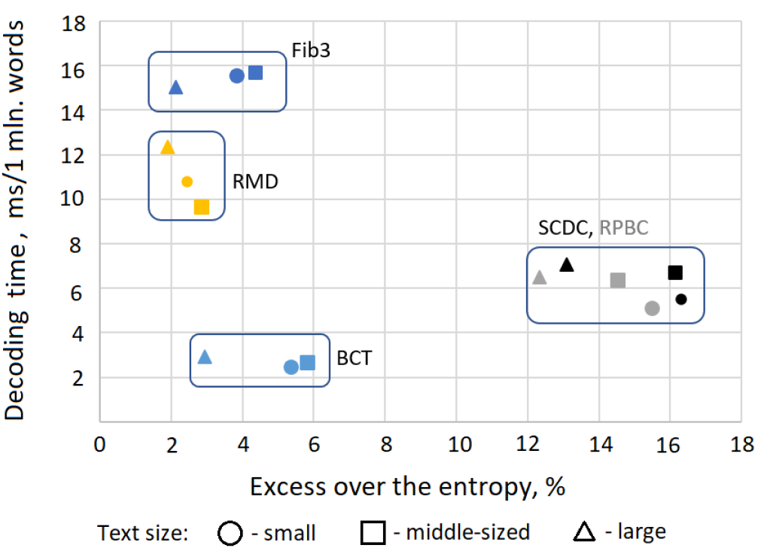
Word-based compression ratio vs. decoding speed
Small: The Bible, KJV, 3.95 MB, 766 112 words int total, 28 659 different words.
Middle-sized: articles randomly taken from Wikipedia, 116 MB, 19 507 783 words in total, 288 179 different words.
Large: the first half of the largest file from Pizza&Chilie Corpus, 512MB, 92 424 896 words in total, 1 686 371 different words.

Slide 46
Compressed search time (milliseconds)
I.O. Zavadskyi. Fast Exact Pattern Matching by the Means of a Character Bit Representation. // SN Computer Science, v. 3:181, Topical Issue “String Processing and Combinatorial Algorithms”, pp. 1–20, 2022.

Slide 47
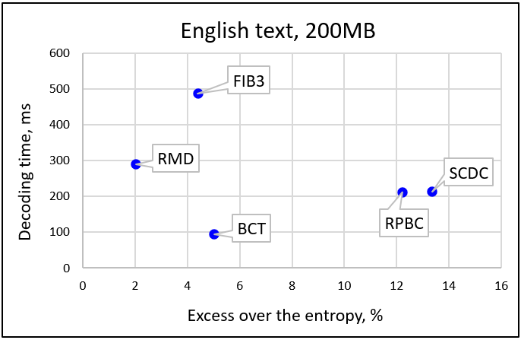
How to improve the BCT compression ratio?
Compose codewords of digits of different bitlengths.
The main idea of BCMix codes

Slide 48
Binary coded mixed-digit (BCMix) code definition
Let $b_{0},…,b_{n}$ are natural numbers and $b_{n+1}=b_{n+2}=…=2$.
The codeword of ${Mb}_{0},…,b_{n}$ code is the sequence of binary values $x_{0},…,x_{k−1},{mask}_{k}$, where $0≤x_{i}<2^{b_{i}}−1,$and
${mask}_{k}=2^{b_{k}−1}={1…1}_{2}$ is the delimiter.
Zavadskyi, I., Kovalchuk, M. Binary Mixed-Digit Data Compression Codes. In: String Processing and Information Retrieval. SPIRE 2023. Lecture Notes in Computer Science, vol 14240, pp. 381–392, 2023.

Slide 49
Codewords of the code M34 (=M3422…)

Slide 50
BCMix decoding
Digits in the BCMix code have almost the same meaning as in any positional number system, except for:
Lefmost digit is least significant;
Leading (and ending) zeroes are allowed.
Natural for a left-to-right script

Slide 51
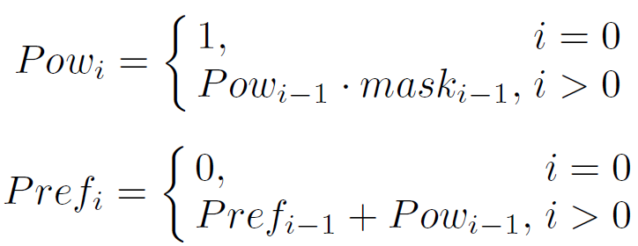
BCMix decoding

Slide 52
BCMix decoding in parts
$$x_{0},…,x_{p_{1}},x_{p_{1}+1},…,x_{p_{2}},…$$
$$P_{1}$$
$$P_{2}$$
$$\sum_{i=p_{j−1}+1}^{p_{j}}{x_{i}⋅{Pow}_{i}}$$
The j-th part is decoded by the formula $Dec\left(P_{j}\right)=$
The whole m-digit codeword is decoded as
$\sum_{j}{Dec\left(P_{j}\right)}$+${Pref}_{m}$

Slide 53
BCMix decoding in parts
$$\sum_{i=p_{j−1}+1}^{p_{j}}{x_{i}⋅{Pow}_{i}}$$
The values $Dec\left(P_{j}\right)=$
can be taken from lookup
tables, $L(P_{j})$.
If we always start the decoding from the beginning of a codeword and digit lengths of parts are fixed, we need only $Pmax$ sets of lookup tables, where $Pmax$ is the maximal number of parts in a codeword.

Slide 54
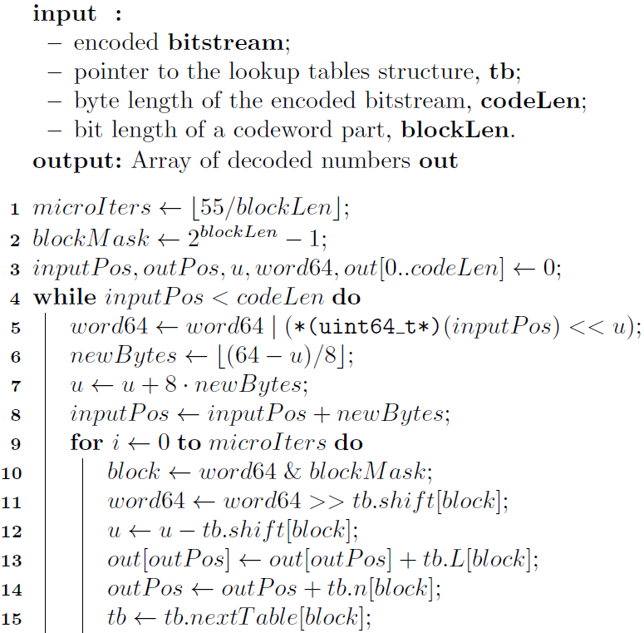
BCMix fast decoding
tb.L – the decoded values taken from the block of digits;
tb.n – the number of codewords that start in the block of digits;
tb.shift – the bitlength of the machine word shift;
tb.nextTable – the pointer to the lookup table structure for the next part.

Slide 55
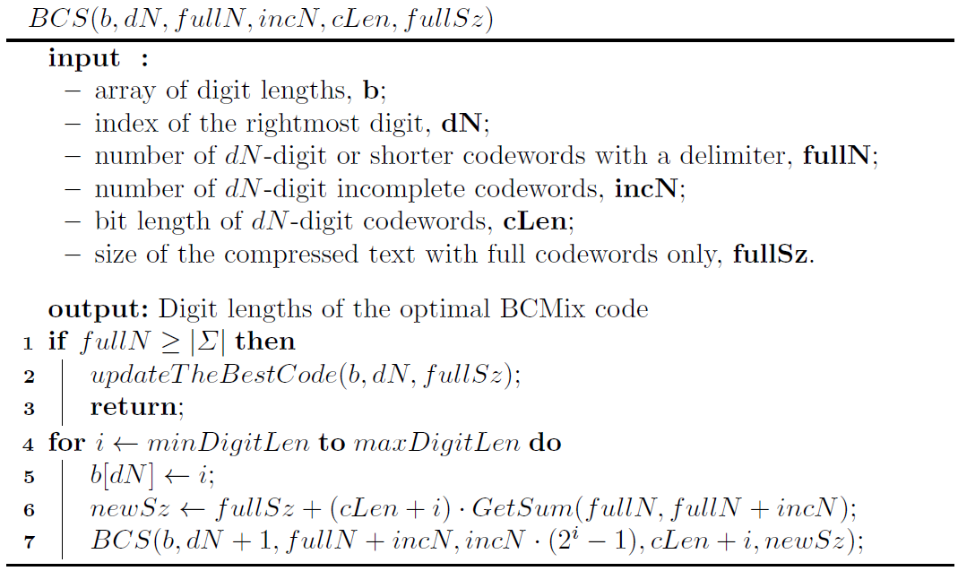
Finding the optimal code
Time complexity:
$$\text{O}\text{(|}\text{Σ}\text{| +}\left|C\right|\text{)}$$
Alphabet size
Number of codes
It makes sense to vary the bitlengths of 4 leftmost digits only, in the range $2≤b_{i}≤4$.
$$\left|C\right|=81$$

Slide 56
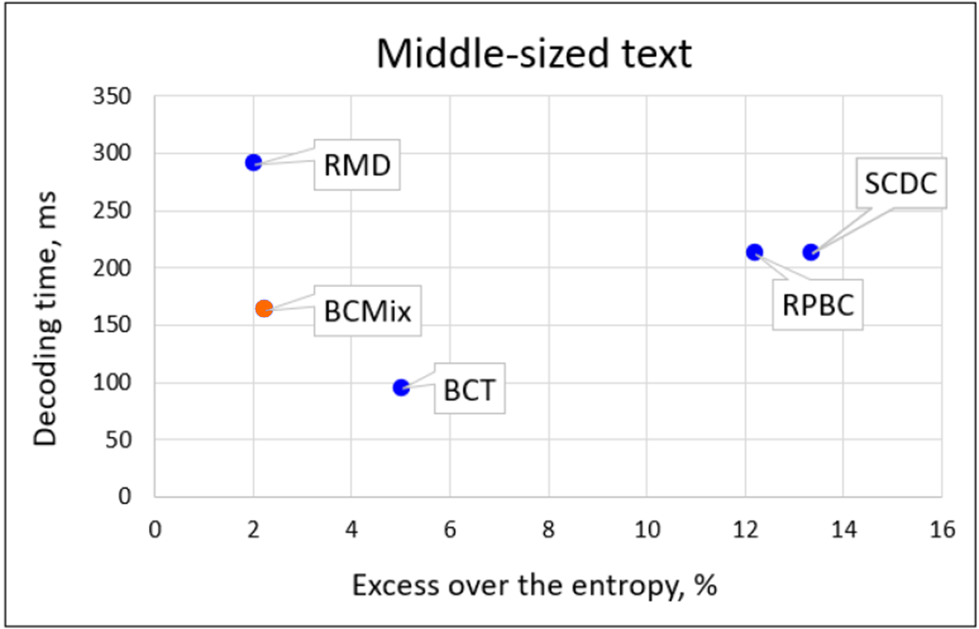
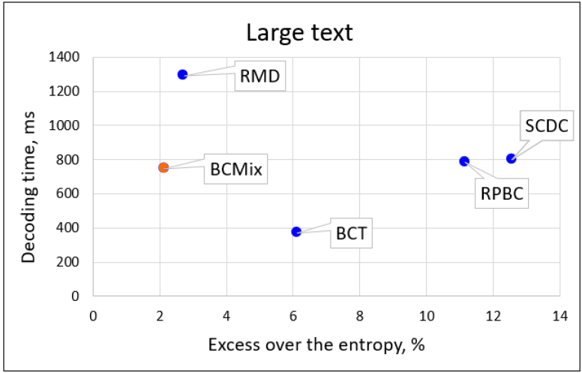
Experimental results
M423
M4
200MB English text from Pizza&Chilie corpus
1GB enwik9, English Wikipedia articles collection

Slide 57
Experimental results
Compressed text size (bytes) + excess over entropy (%)
Decoding time (milliseconds)

Slide 58
Alternative solutions
Canonical Huffman codes – offer the same compression ratio as Huffman codes but can be decoded 20–30% faster.
K-flat codes – can be decoded 20–30% faster than canonical Huffman codes at the cost of 4–6% extra compressed size on large alphabets.
M. Liddell and A. Moffat. Decoding prefix codes. Software – practice and experience, vol. 36, pages 1687–1710, 2006.

Slide 59
BCMix codes in LZ77 compression (BC-ZIP)
Original file | BC-zipped file (optimal space) | M444 (offsets)+ SODA_09 (lengths) | Gain
alice29.txt (152 KB) | 57,708 | 55,092 | 4,53%
kennedy.xls (1 MB) | 327,716 | 306,542 | 6,46%
English – 1MB | 337,205 | 328,401 | 2,61%
English – 2MB | 730,255 | 715,874 | 1,97%
English – 50MB | 11,594,901 | 11,506,330 | 0,76%
Andrea Farruggia, Paolo Ferragina, Antonio Frangioni and Rossano Venturini. Bicriteria data compression. In SODA, pages 1582–1595, 2014.

Slide 60
BCMix codes in adaptive encoding
Algorithm
Idea
Code length
Encoding time
Decoding time
FGK (1973-1985), Vitter (1987)
Updating Huffman tree after every bit processing
H+2+δ
H+1
H+1
H+1+δ
Karpinski and
Nekrich (2009)
Quantize adaptive canonical coding; updating code at intervals
H+1
1
lg H+1
Shannon coding over smoothed distribution; updating code at intervals
H+1
1
1
Gagie (2022)
New algorithm idea: use a fixed codeword set but re-index in O(1) time while processing each symbol.

Slide 61
Adaptive coding – experimental results
 | Vitter’s algorithm |  |  | New Algorithm
Text | Compressed size (bytes) | Encoding time (s) | Decoding time (s) | Compressed size (bytes) | Encoding time (s) | Decoding time (s)
Harry Potter (430 KB) | 87,151 | 0.073 | 0.245 | 88,036 (+1,02%) | 0.0044 16x faster | 0.0051 48x faster
Shakespeare (5,09 MB) | 1,123,152 | 1.838 | 1.947 | 1,149,684 (+1,00%) | 0.042 44x faster | 0.047 41x faster
Pizza&Chilie corpus (50 MB) | 12,164,227 | 28.756 | 28.591 | 12,304,232 (+1,15%) | 0.404 71x faster | 0.398 72x faster

Slide 62
Integer Retrieval from Unordered Compressed Sequences
The classical Clarck’s solution can be extended to the case of RMD-bitstream providing constant time random access at the cost of $\frac{3n}{\left\lceil \lg{\lg{n}}\right\rceil }+O(n^{\frac{1}{2}\lg{n}lg{\lg{n}}})$ extra space.
D. R. Clark. “Compact Pat Trees”. PhD thesis, University of Waterloo, 1996.
However, for bit sequences up to 4GB this value exceeds 60% of the sequence itself.
0 | 1 | 1 | 0 | 1 | 1 | 0 | 0 | 1 | 1 | 1 | 0 | 1 | 1 | 0 | 0 | 0 | 1 | 1 | 0 | 1 | 0 | 1 | 1 | 1 | 0
I. Zavadskyi. Efficient Integer Retrieval from Unordered Compressed Sequences. Proceedings of the Prague Stringology Conference. – 2023, pp. 83–96.

Slide 63
Integer Retrieval Experiments
Experiments on integer sequence obtained by applying either word-based or
character-based frequency compression to 200MB English text from Pizza&Chili corpus.
Word-based
Character-based

Slide 64
Conclusions
Multi-pattern codes represent a set of agile code families, which can be efficiently used in data compression, particularly on large alphabets. They allow to combine
good compression ratio (up to 2–3% beyond the H0 entropy)
with
decoding-in-parts principle, allowing to perform very fast decoding (orders of magnitude faster than Huffman codes).
The multi-pattern codes can be useful in different data compression- related applications, such as semi-static and LZ-77 compression, adaptive encoding, and direct access to compressed data.
They deserve higher attention from the stringology community!

Slide 65
Thank You!
Igor Zavadskyi
ihorza@gmail.com

